Slide 1
Software Engineering and Architecture
Networking 101

Slide 2
Motivation
Networking - not a curriculum issue in SWEA…
  … it is next semester in another course
But…
  You see it everywhere
  And you need some ‘Network for dummies’ for our Broker…

Slide 3
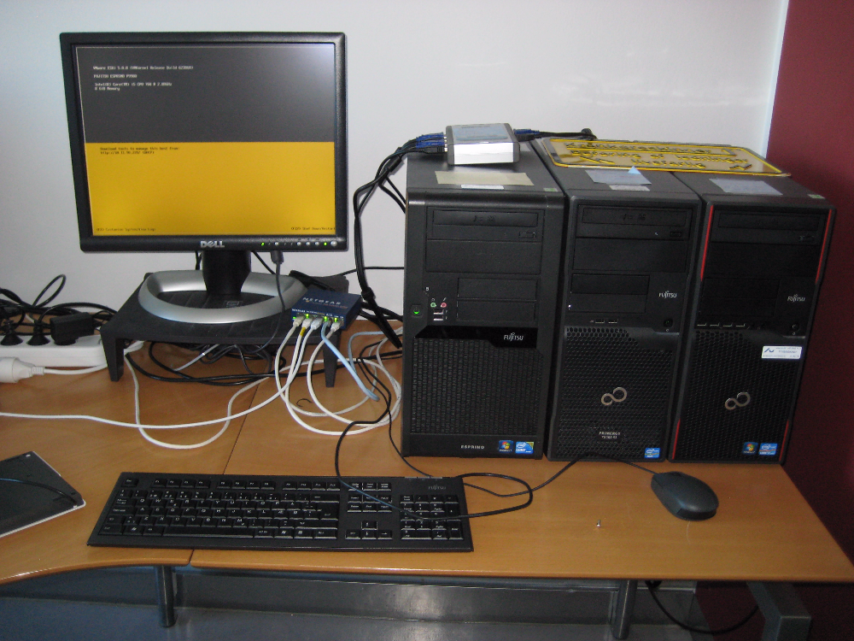
A Network
… in CS is basically two or more machines connected by electrical wires that allows us to send signals between the machines…

Slide 4
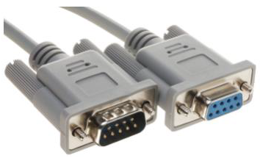
A Network
My first exposure: RS232 on Z80 CPUs
Today’s web: TCP/IP over Ethernet

Slide 5
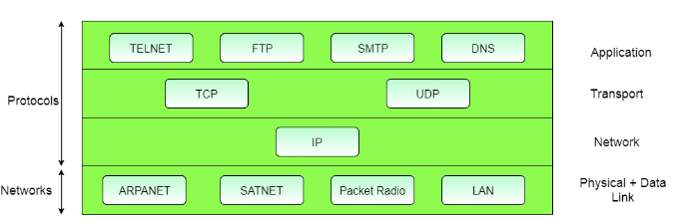
TCP/IP
Transmission Control Protocol and Internet Protocol
  By the US Department of Defence (DARPA)
Key Idea
  Segment transmission into Packets (”Datagrams”)
  Layered architecture, each with specific responsibilities (roles!)

Slide 6
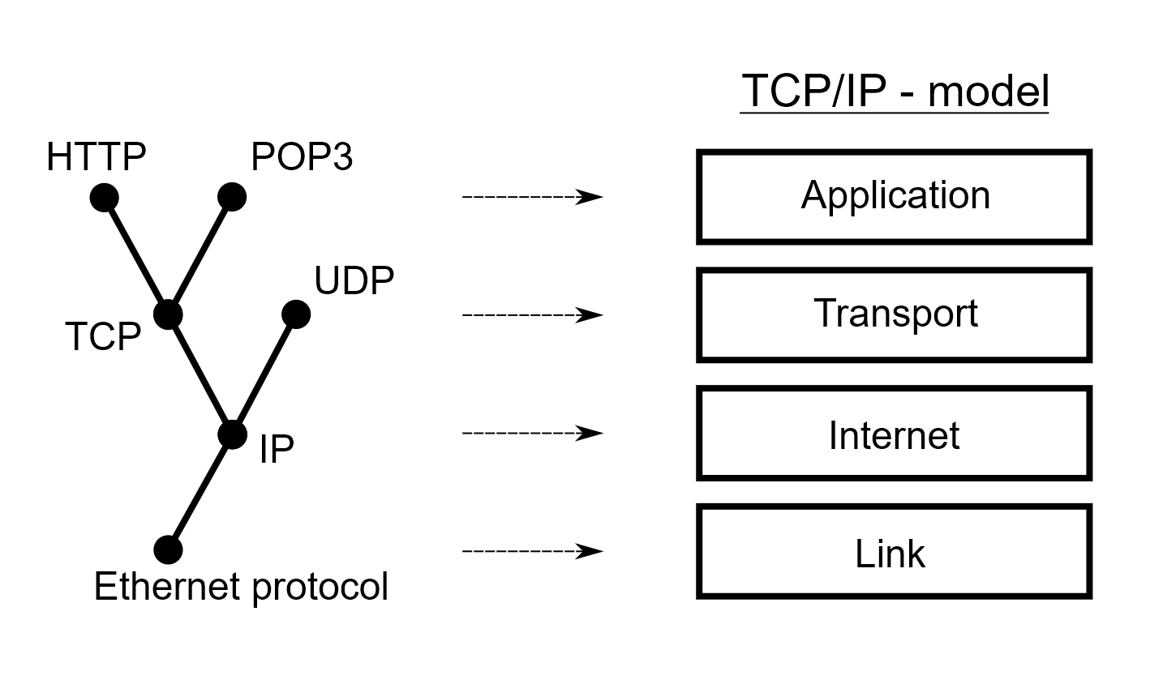
TCP/IP
By Jsoon eu (talk) - I (Jsoon eu (talk)) created this work entirely by myself., CC BY-SA 3.0, https://en.wikipedia.org/w/index.php?curid=29962617

Slide 7
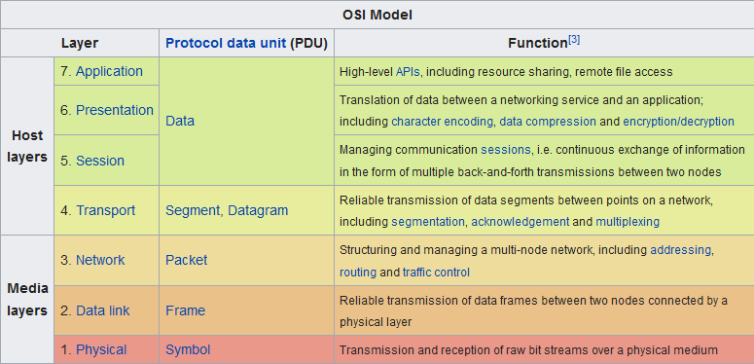
OSI Model
Another but similar model

Slide 8
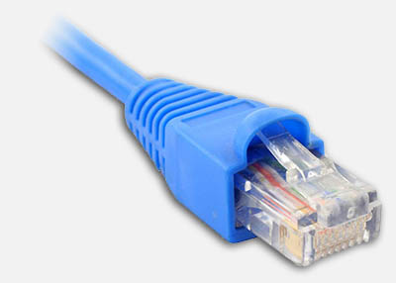
TCP/IP Layers
Transport layer
  TCP Reliable, ordered, error-checked data delivery
    Transmission Control Protocol
Network / Internet Layer
  IP Relaying datagrams across networks
    Internet protocol
Physical + Data Link Layer
  802.3 Ethernet Hardware and cables
  802.11 WiFi Cables gone

Slide 9
Internet Protocol
IP: Send datagram

Slide 10
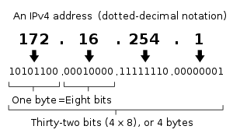
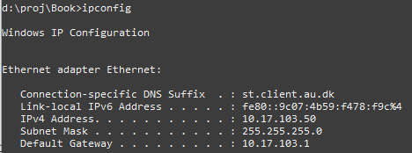
IPv4
Defines the terminology that we use and it pops up even at the software level
Every computer on the network has an address
  Type ‘ifconfig’/’ipconfig’ to find yours
Some ranges are reserved
  10.*.*.*, 172.16.*.*., 192.168.*.* are private networks
  127.0.0.1 is localhost = myself
Notes:
Only 4.3 Bill network addresses possible, less than # of people on earth!

Slide 11
IP and Ports
So given an IP (like 91.221.196.224) you uniquely identify a computer
The OS of that computer expose 64K ports
  Also predefined port numbers
    7: echo (‘ping’)
    20: ftp
    22: ssh
    80: HTTP
    443: HTTPS
Thus
  91.221.196.224:80 is the HTTP port of a specific computer
    If port 80 is active it is probably a web server
Think: port = dueslag/“postkasse”

Slide 12
Ports
On Linux, all ports below 1024 are reserved for ‘root’
  Only superuser (administrator) can use these…
Above that, it is ‘free game’ to assign/use a port, but you may interfere with other programs that have picked one...

Slide 13
Datagram
So, for node A and node B to communicate some data
  Say, a request for a web page, and the server reply
A creates a request
  N datagrams (the data segmented into packet size)
  Each datagram contains
    Part # i (”packet i”) of the full data
    Destination IP address Who is to receive?
    Source IP address Who should have the reply?
B creates a reply
    Of course the same ☺

Slide 14
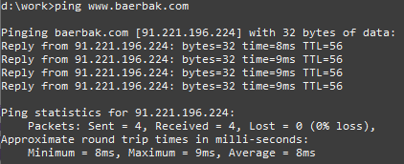
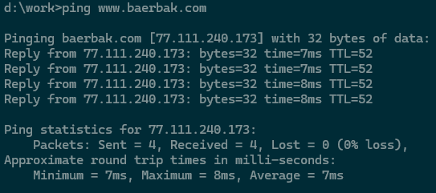
Ping
Port 7 is reserved for ‘ping’
  A classic availability pattern: ‘ping/echo’
    Verify that a given machine is currently turned on
I have a computer running ‘www.baerbak.com’
Will send datagram on port 7 and print round trip time

Slide 15
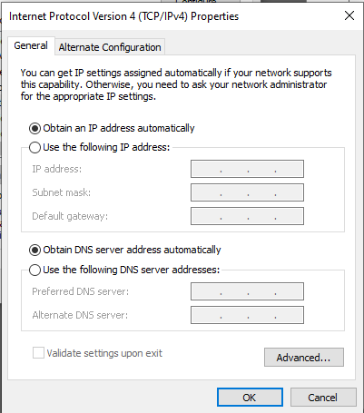
Uhum?
So how did your machine get that IP address?
Either static IP (never used except…)
  You assign an IP directly on the machine!
    (and hope no other on the network has
    the same address!)
Or dynamic IP
  DHCP – dynamic host configuration
  protocol
    Broadcast a “help – I need an address”
    DHCP server will assign one and give it
      Usually your router at home
      At CS it is a dedicated server machine

Slide 16
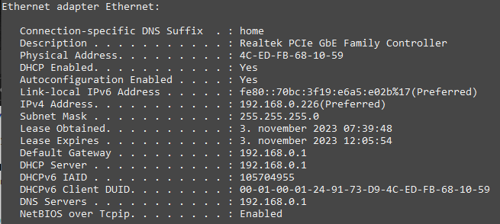
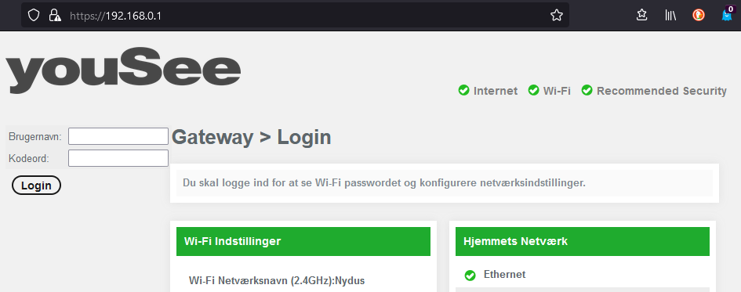
DHCP
On my Windows machine at home...
  ipconfig /all
Which is the IP of my router…

Slide 17
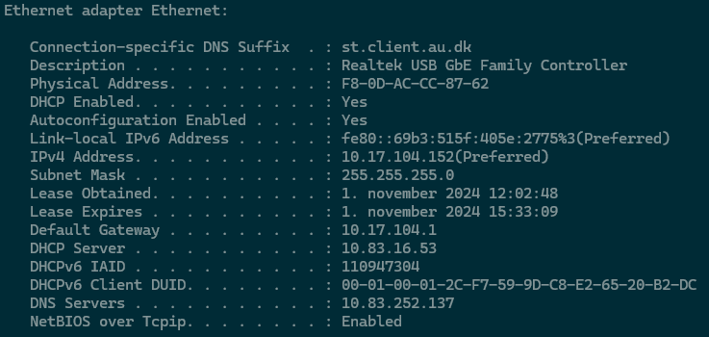
DHCP
On my Windows machine at my AU office
  ipconfig /all
And here at AU…

Slide 18
Domain Name System
IP addresses are a bit hard to remember, right?

Slide 19

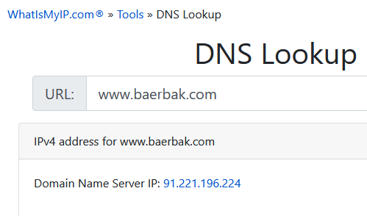
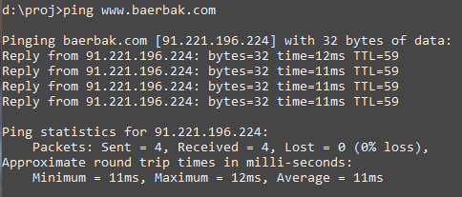
DNS
Who can remember 87.238.248.136 ???
DNS (Domain Name System) are Name Services
  Computers that translate names into IP addresses

Slide 20
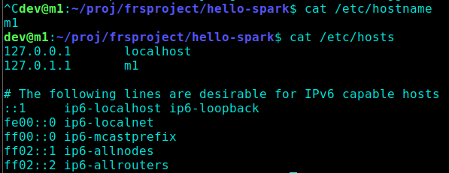
Local names
Any computer has its own name
  Normally you give it a name when installing
On Linux you may change it by editing a few files
Localhost is 127.0.0.1 which is the IP address of the computer itself! The name of it is ‘localhost’

Slide 21
Your Own DNS
You can actually maintain your own DNS by editing the hosts file on Linux
  Do not ☺ - it only works on my machine!

Slide 22
Local DNS
At my home I have a WiFi Router, supplied by my internet provider. It creates a local network with local names
Of course, only computers on this network can access each other by their names
  Not visible on the ‘full internet’

Slide 23
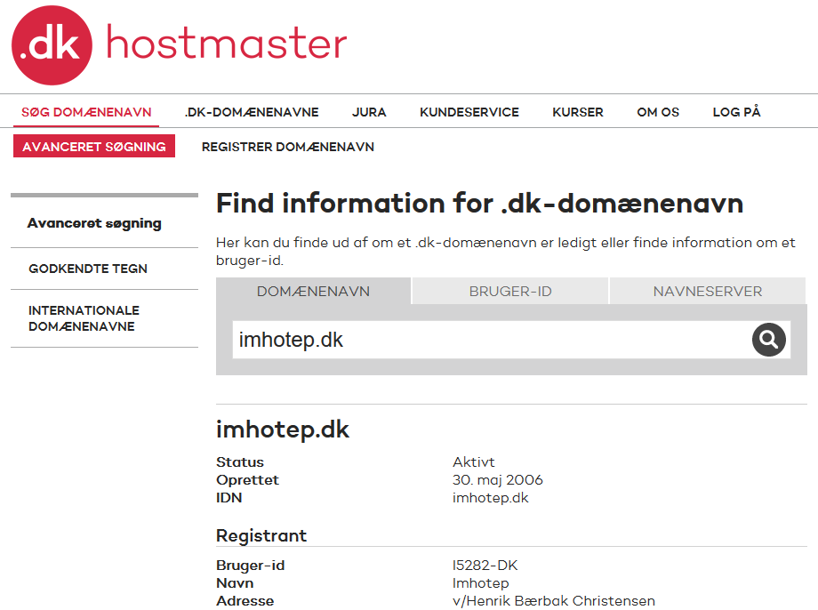

Global DNS
But what if I want to expose a node on the full internet?
So – how do I get a global domain name?
For ‘.dk’ domains DK-Hostmaster keeps track of all Danish domains
It costs money
  ~50 Dkr pr year
    I own littleworldk.dk,
    imhotep.dk, and baerbak.dk
Now: punktum.dk

Slide 24
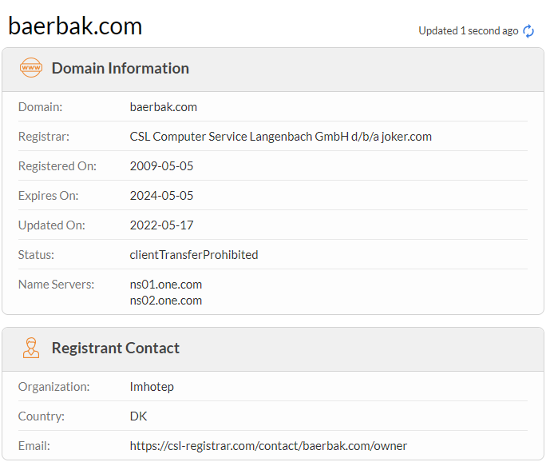
Global DNS
For other domains, you
need a ‘registrar’ that
handles global registration
for you
(From 2025, you also
need that for .dk domains)

Slide 25
Name Servers
But you only register the domain, you need a Name Server to handle the actual lookup
  My web sites are hosted
  by one.com, and they
  provide the
  name servers
Exercise
  Why do you think there
  are two name servers
  listed ?

Slide 26
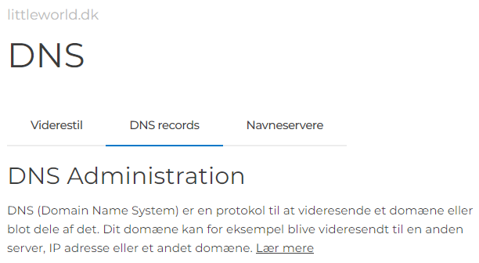
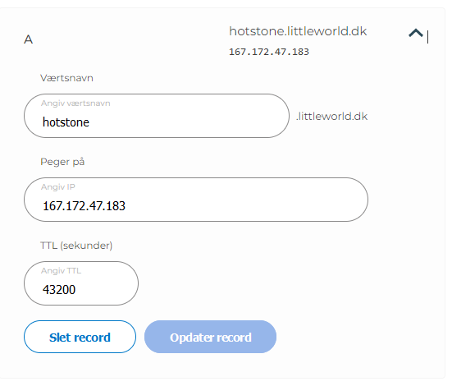
Create a New Name
Scenario: I want to provide a HotStone game server
I do
  Rent a virtual machine on Hetzner (Serverfarm in Helsinki)
    So I get an IP address of that machine
I log into my ‘one.com’ account, go to the ‘DNS Setting’
pane, and create an ‘A record’ with that IP address

Slide 27

Local DNS
Organizations, like CS, maintain their own local network
  And thus needs a DNS for the local machines
    Which are ‘visible’ on the local net, but not on the global (=inter)net
One of my machines is m1-dev on st.lab.au.dk network

Slide 28
Resolving Names

Slide 29

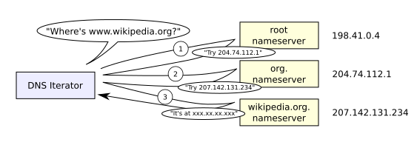
Name Resolution
Any node on the IP network has a (local) Name Server registered, the one to contact first
  Windows: ‘nslookup’
  Linux: ‘nslookup’ ☺
Algorithm: ”If I do not know, I know who knows”
  Picks the name apart right to left!
    org before wikipedia before www

Slide 30
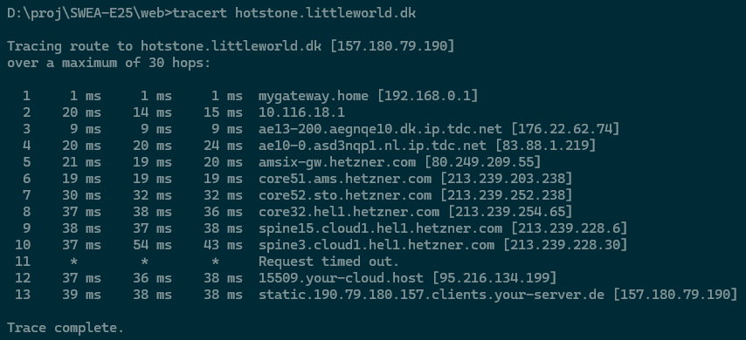
You may trace the lookup path
Windows 11

Slide 31
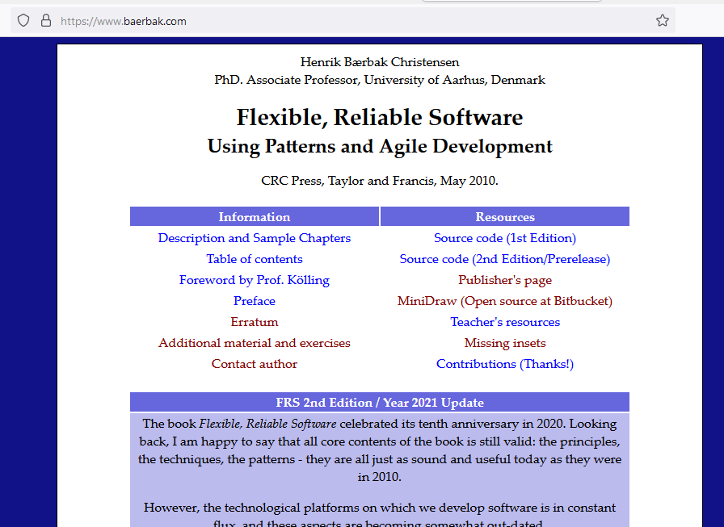
So…
baerbak.com will become
  https://www.baerbak.com
Firefox calls DNS server
  Translate it into IP address
Firefox will then send a
http request to port 80 on that
ip address (actually 443 as
it is the ‘secure http’ port)
… which will return a HTML
document

Slide 32
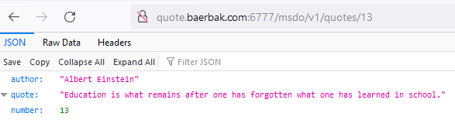
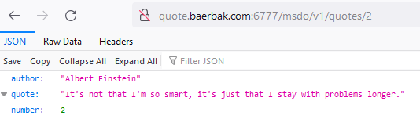
Or…
I start my ‘quote service’ on a DigitalOcean machine in Amsterdam, on port 6777, assign ‘quote.baerbak.com’ to that IP, and can now get famous quotes in JSON format:
Notes:
Meta: dev@m1e18hbc:~/proj$ docker run -d -p 6777:6777 henrikbaerbak/quote:msdo_1_0_1

Slide 33
Performance
Of course, contacting 3-8 servers just to resolve a DNS entry is extremely expensive
Caching Tactic: ‘Maintain multiple copies of data’
  Each DNS server caches the lookup
    So my local DNS server knows the address immediately the next time I ask
  Browsers maintain their own caches!
    No need to talk to the DNS at all after initial domain name has been resolved…

Slide 34
Time To Live
But but – what happens when IPs change then?
  All the caches will send requests to the old node?
The principle of delegation is used in DNS
  I move my HotStone server to another provider – and get a new IP address
  The DNS system has to adapt: TTL: TimeToLive here 12h
Takes up to 12 hours world-wide

Slide 35

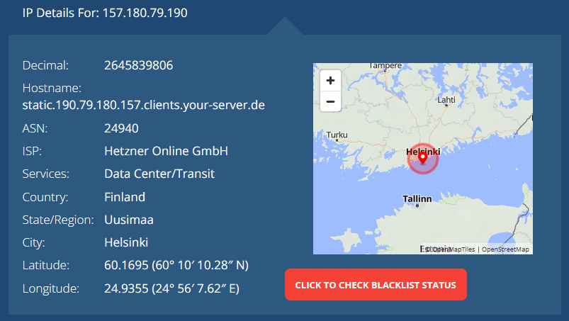
Fun Services
DNS and IP are of course ‘public knowledge’, so there are quite a few fun services to lookup data out there.

Slide 36
Summary
To send a datagram, you have to know the address of the receiver
Every node in an IP network has an IP address
  IP address xxx.xxx.xxx.xxx (or IPv6)
Nodes for a wider audience use DNS servers to assign a hostname to a specific IP address
  www.dr.dk instead of xxx.xxx.xxx.xxx
Every node has 65.536 ports
  Quite a few below 1024 are reserved

Slide 37
TCP
The last piece of the puzzle

Slide 38
Actually, rather hidden
IP splits data into packets/datagrams and sends them
  But they get lost!
  They become garbled
  They arrive out-of-order
TCP introduce reliability
  Get packet 1, 2, 3, 5, 7, 6...
  Request packet 4 again, and 7 as it was garbled
  Forward the full data by putting segments in correct order

Slide 39
Network Address Translation
Weird Behaviour Warning

Slide 40
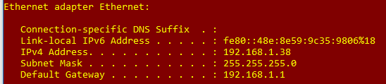
Segmenting Networks
Organizations, projects, homes create their own LANs.
  Security, convenience, performance
Example:
  My home router that assigns each connected node an IP in the 192.168.x.x space
    But at any time there are
    thousands of machines with
    IP 192.168.1.38
  How does ‘www.imhotep.dk’ know which computer to return the HTML document to, then???

Slide 41
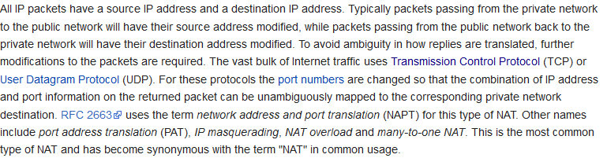
NAT
So NAT in my router simply change IP:port of the datagrams so the web server returns to the router instead; once it has been received, the router forwards to the local node

Slide 42
Implications
NAT makes networking behave ‘weird’:
  I can see you, but you cannot see me!
  My home computer can see the full internet, but no computer on the internet can see mine!
    They can only see my ISP’s (Internet Service Provider) computer, which is the only one that can see my router, which is the only one who can see my computer!

Slide 43
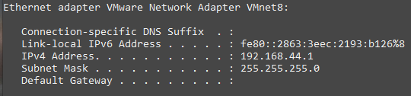
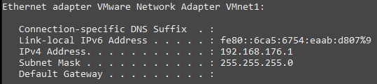
Implications
VMWare Player does NAT between your host machine and the course VM, Mxx, you are running
  It installs additional networks on the host, my Win machine
  Therefore your host has multiple IP addresses, on multiple networks, used by multiple machines
    Meaning host and VM can communicate on the 192.168.*.* network. Remember to use that for local testing!

Slide 44
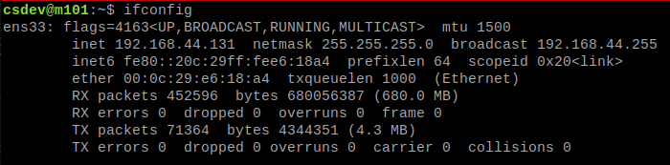


So, in my VM
Running my VM I can see it is also on the 192.168.*.* network
So they
can talk
using these
IP addresses
  Win 10 -> m101
m101 -> Win 10

Slide 45

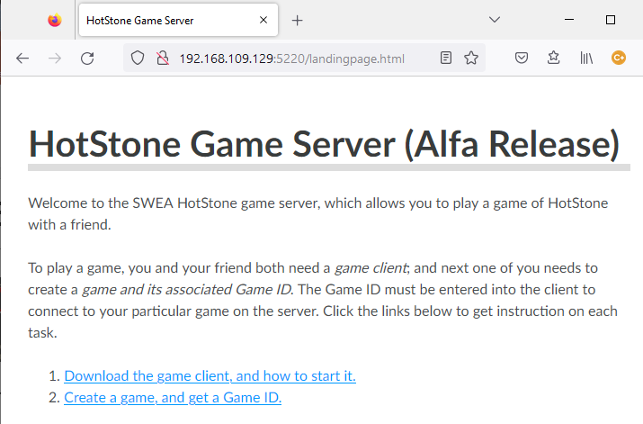
Example
Starting my HotStone server on my m1 VM
Then I can contact it on that IP address from the host:

Slide 46
And…
On EduRoam which most of you are on with your laptops when here at the department…
… things may easily not work!
… because EduRoam maintains firewalls which often deny any communication on non-standard ports
  Only on port 7, 80, 443, 22, and some others
    And subject to changes all the time!

Slide 47
Handy commands

Slide 48
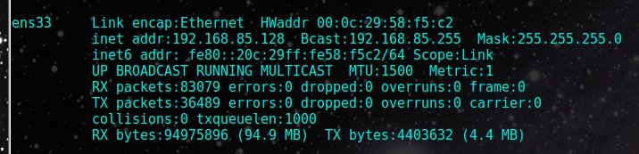
Some Nice Network Commands
Debug 101
  Can my computer see the other computer???
    ‘ping www.imhotep.dk’
    ‘ping 192.168.1.37’
What is my IP?
  Windows: ipconfig / linux: ifconfig
If not installed, issue
sudo apt install net-tools
to get it ☺

Slide 49
Summary
The Distributed course will go into the more details
  I think ☺
Lot of concepts, but not core curriculum in SWEA
However, you will bump into some of these issues in the mandatory project on distribution...
  Client and Server need to talk – using their IP addresses and ports…

